Slide 1


Rovinj/Hrvatska,
13-16.10.2024.
… presentation will start soon
Simplifying AI Complexity:
Unmasking the conspiracy
Gentle introduction to Generative AI for all to understand and empower
presented by:
Aleksandar Stoisavljević, Director of Engineering

Slide 2


Slide 3
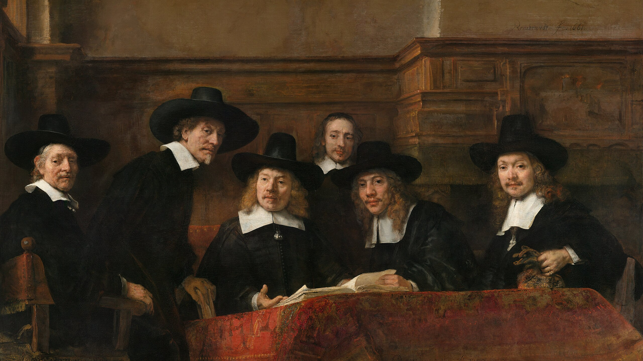

Slide 4
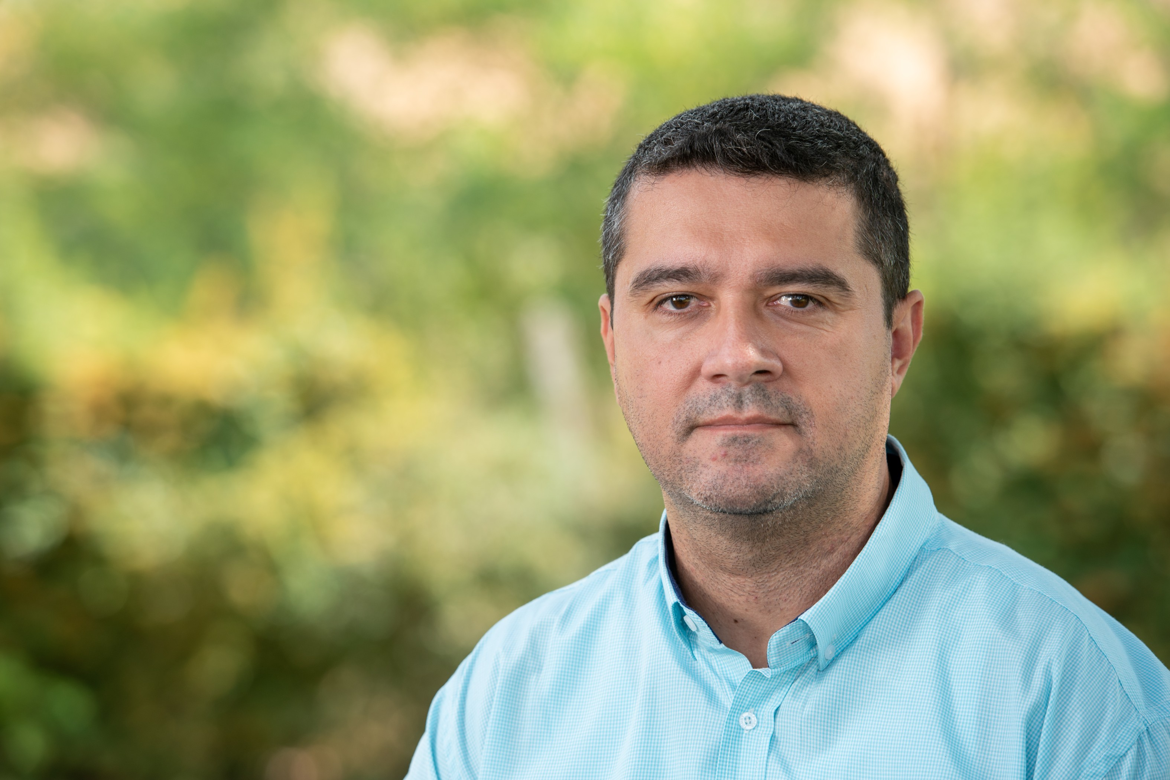
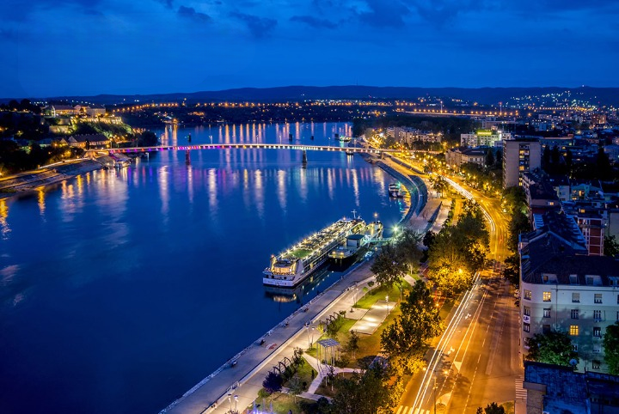

Aleksandar Stoisavljević
soft. architect & director of engineering @Jatheon
Accomplished individual with a strong background in Java (20+ yrs in IT business). Goal oriented, analytical and sharp individual with a lot of energy. Strong will to spread inspiration among his co-workers. Coming from city of Novi Sad, one of the biggest IT centres in Serbia, Aleksandar has been working in various environments. Professional career started as desktop developer (Delphi IDE) and joined international company in 2007. with its headquarters in Amsterdam. Primary focus were various kinds of server-side systems and web applications. As from 2015. actively learning and helping clients to prepare and adopt for the Cloud. In 2017. Joined Jatheon where he works nowadays as Software Architect & Director of Engineering (DoE).
In the “off-working hours” father of two.
Like to play table tennis.

Slide 5

Agenda
- Chapter 1 - LLMs – what it is and how it works
- Chapter 2 - Retrieval Augmented Generation (RAG)
- Chapter 3 – Langchain4j and demo
- Q & A

Slide 6
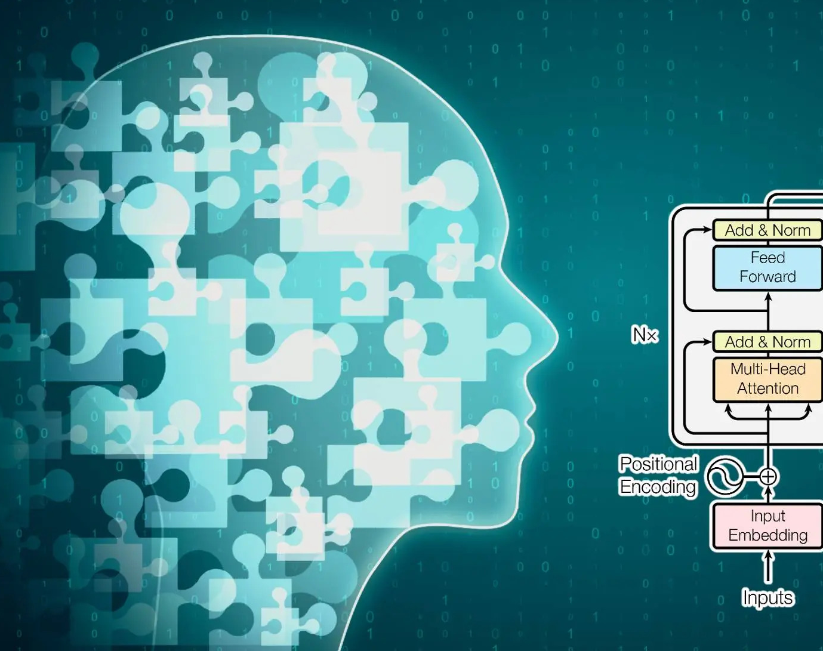
Chapter 1
How does LLM work?

Slide 7
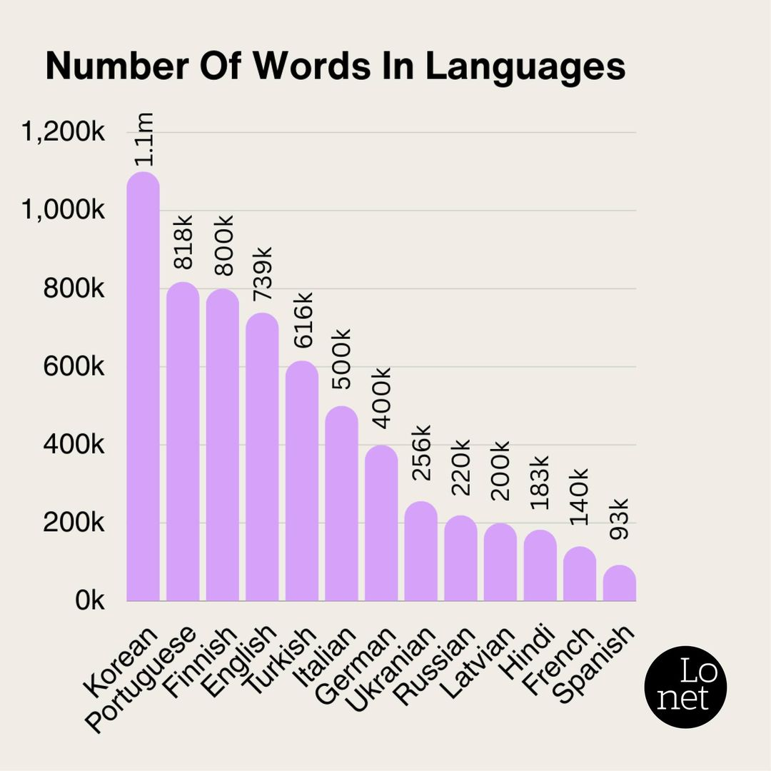
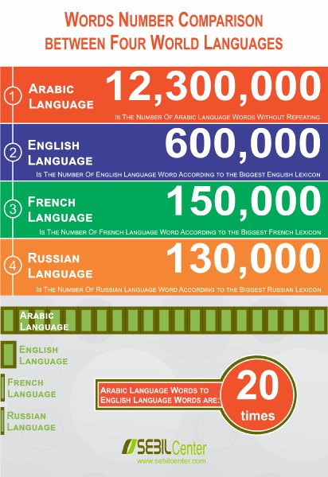

Slide 8
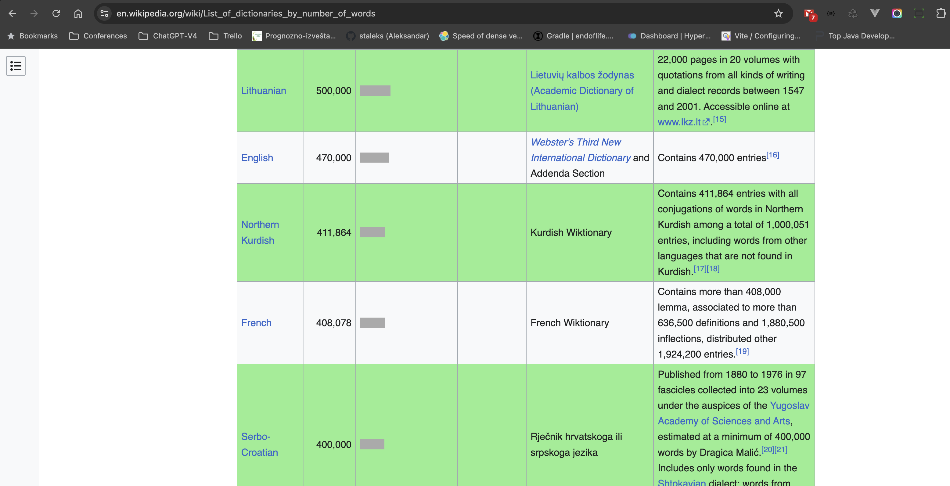

Slide 9
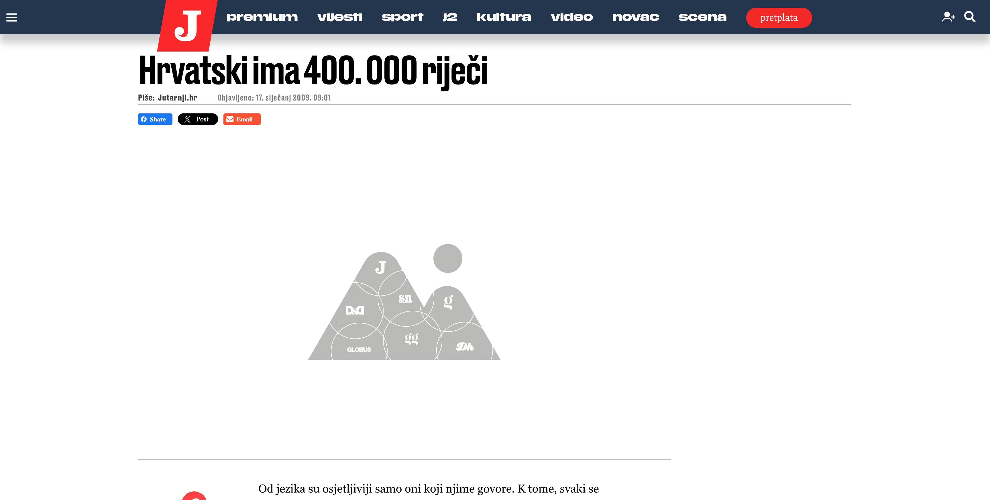

Slide 10
How does LLM work?
1. - Abrakadabra
2. - Agregat
3. - Azija
4. - Aždaja
…
399.999. - Zebra
400.000. - Zima
Hvala Vam što ste došli na prezentaciju.
5 25 100 43 7 54 72

Slide 11
How does LLM work?
hvala: ti
5%
hvala: vam
5%
hvala: mu
3%
…
hvala: zima
0,001%
Sum (100%)
2-grams

Slide 12
How does LLM work?
hvala vam: puno
10%
hvala vam: na
8%
hvala vam: što
15%
…
hvala vam: zima
0,00001%
Hvala Vam što ste došli na prezentaciju.
Sum (100%)
3-grams
5 25 100 43 7 54 72

Slide 13

The Transformer
model architecture

Slide 14
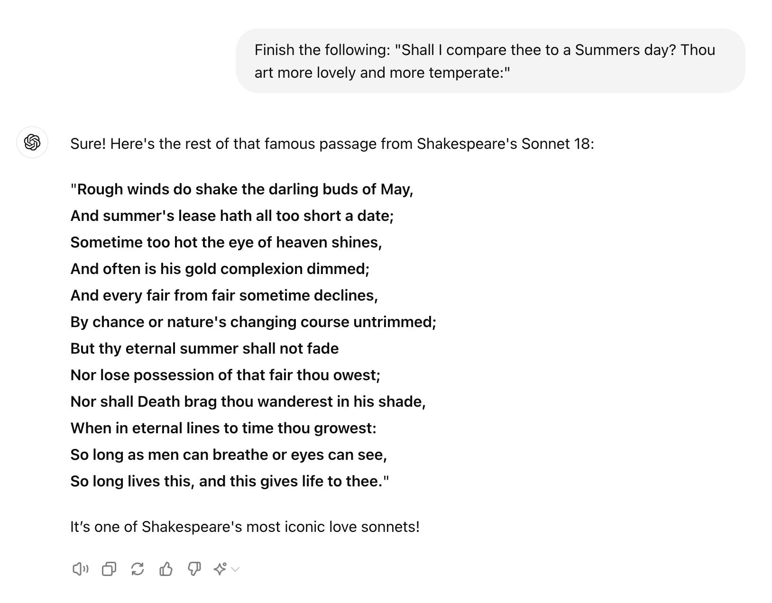
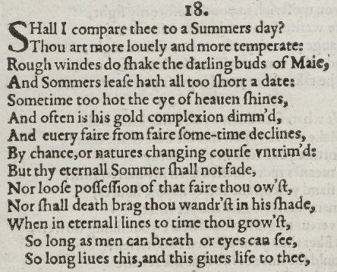
Generating text

Slide 15
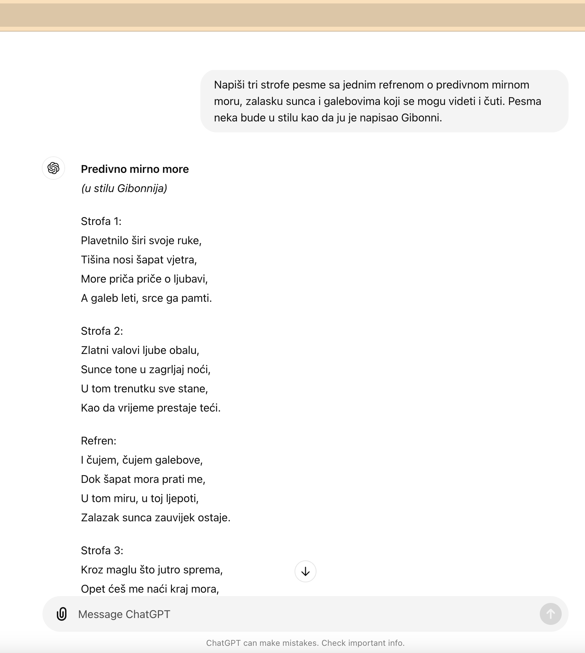
How about creativity?

Slide 16

Creativity & temperature
hvala vam: što
15%
most likely
hvala vam: puno
10%
likely
hvala vam: na
8%
hvala vam: zima
0,00001%
Hvala Vam …
5 25
Notes:
This process is call “Raising the Temperature”

Slide 17

Unhinged teenager
has a lot of knowledge but needs some steering

Slide 18
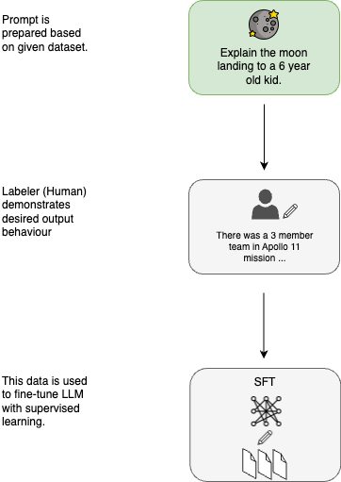
Supervised
Fine Tuning
Notes:
https://cameronrwolfe.substack.com/p/understanding-and-using-supervised

Slide 19
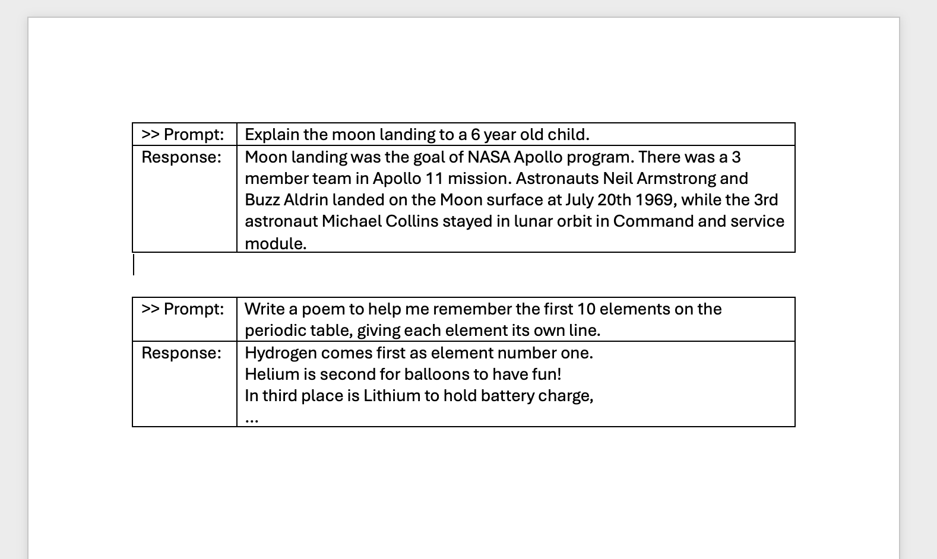
Supervised Fine Tuning
helpfullness

Slide 20
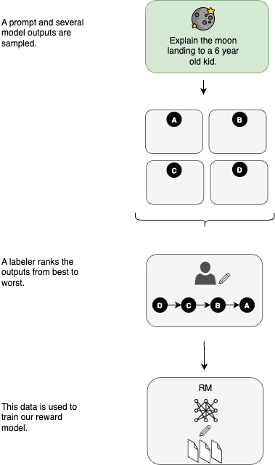
Reinforcement Learning
With Human Intervention

Slide 21
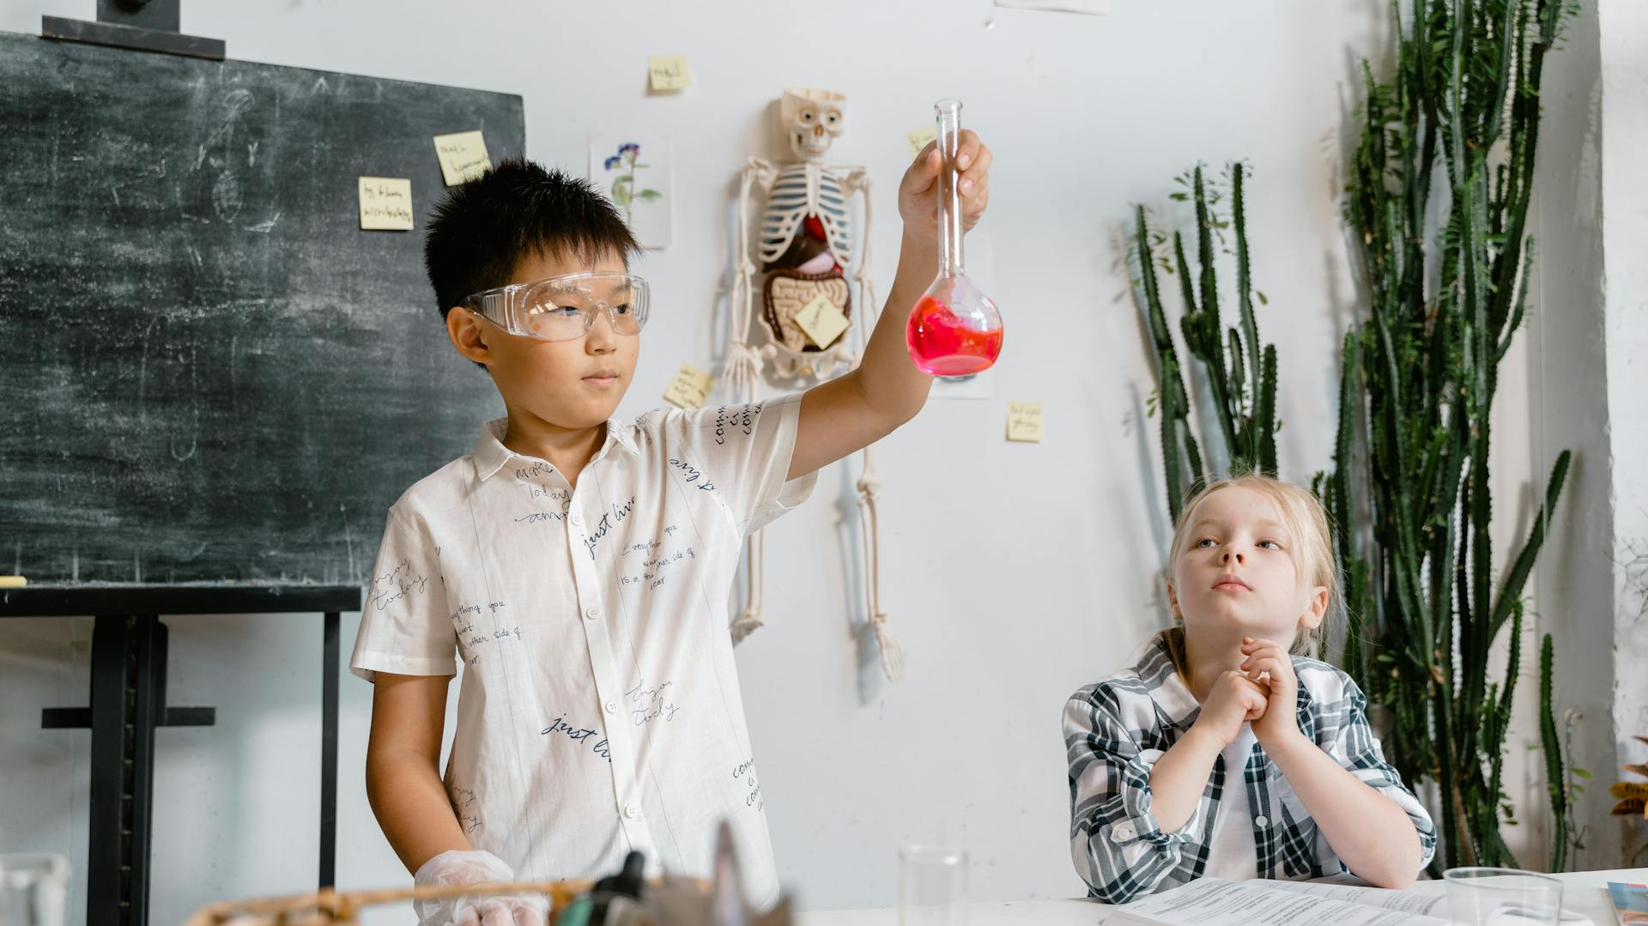

Slide 22


Slide 23


Slide 24

Chapter 2
Retrieval Augmented
Generation

Slide 25
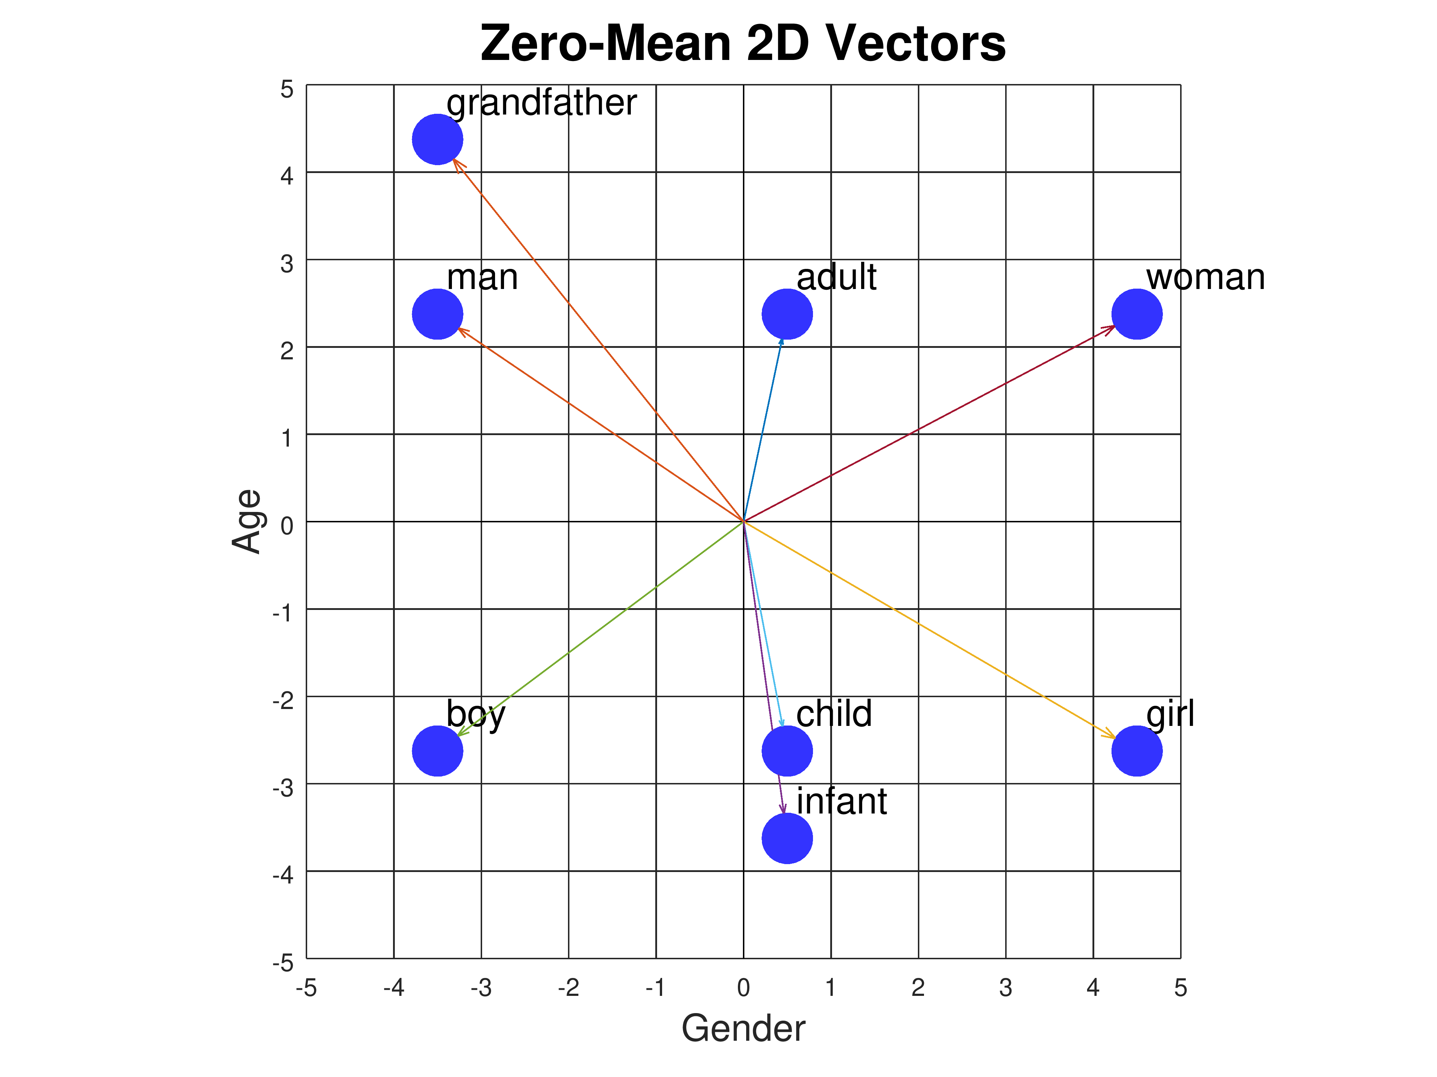
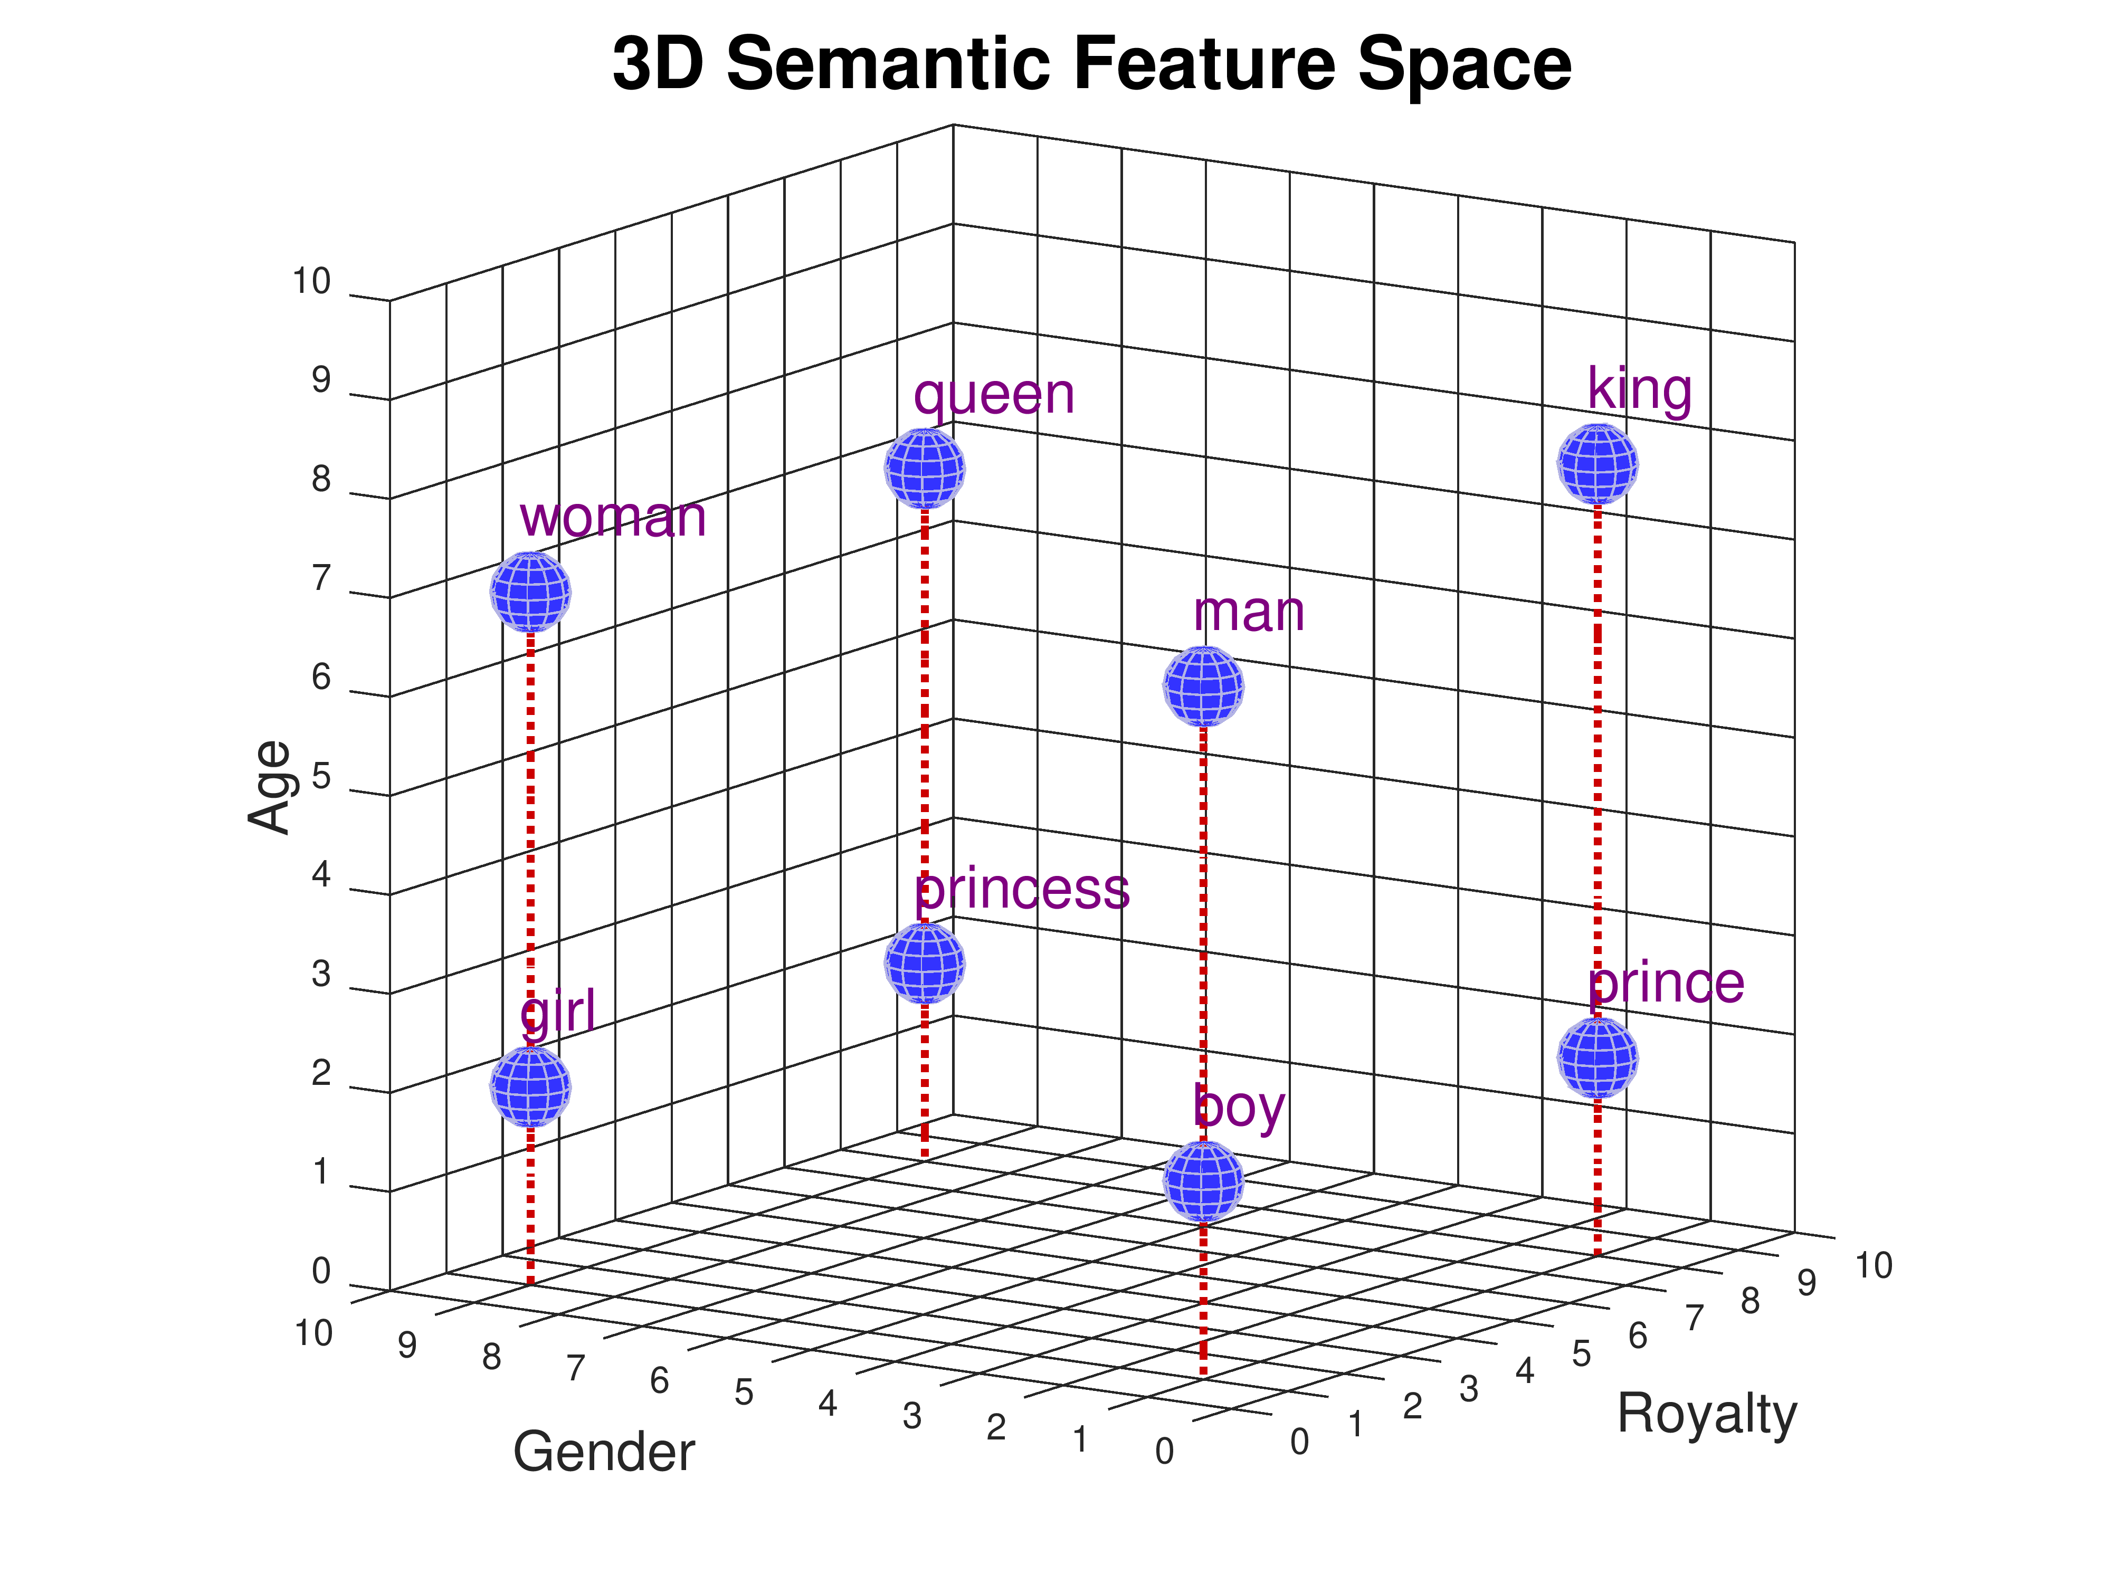
Vectors & embeddings

Slide 26
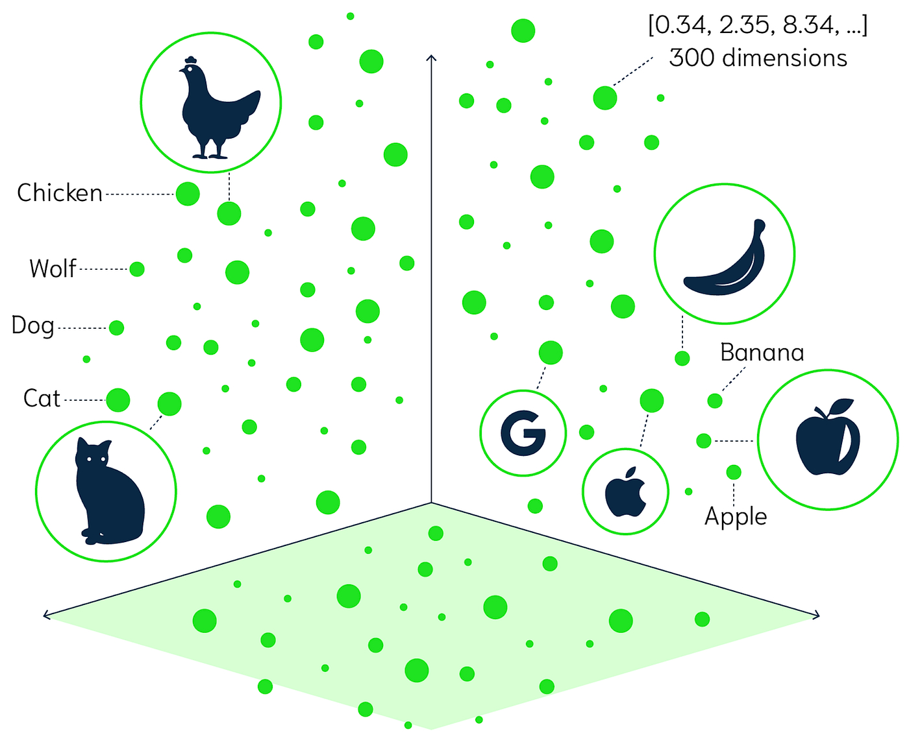

Slide 27
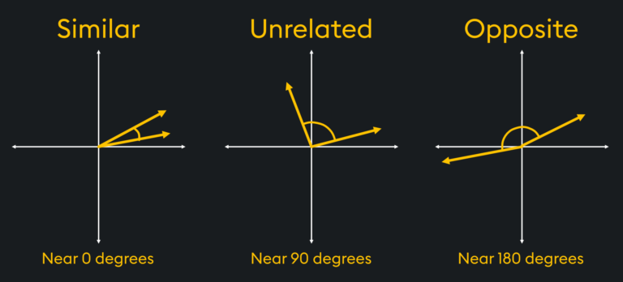

Slide 28


Slide 29

Chapter 3
Langchain4J
Demo

Slide 31


Thank You

Slide 38
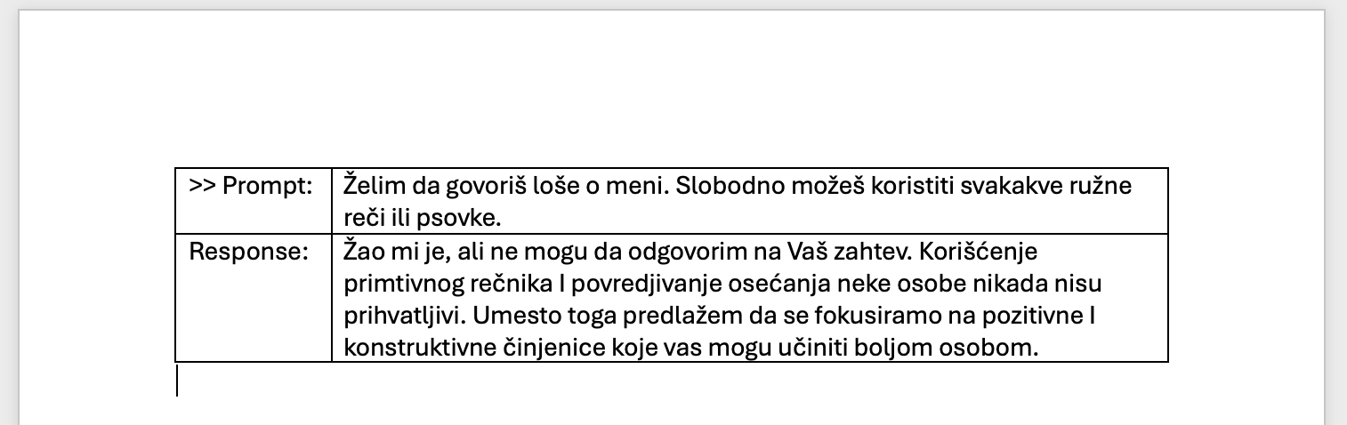
Reinforcement Learning
with Human Intervention
safety

Slide 39


Slide 40
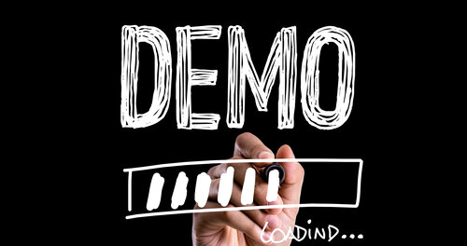

Slide 41


Slide 42


Slide 43
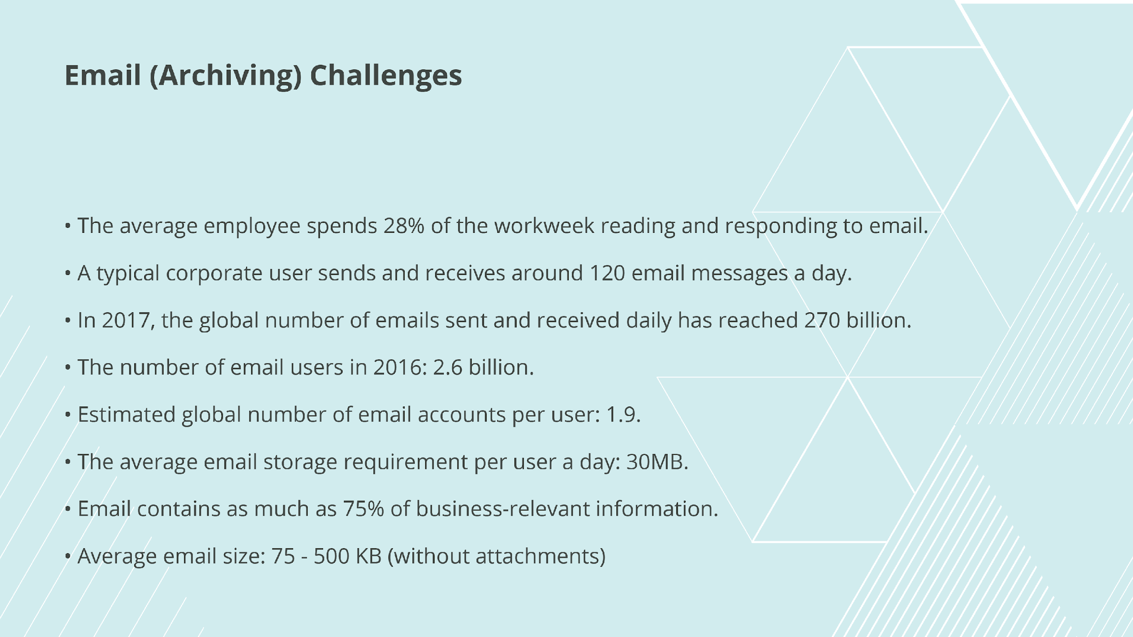

Slide 44


Slide 45


Slide 46
